Slide 1
Hibernate Mapping
Dessign by: DieuNT1

Slide 2
Lesson Objectives
Understand the type of hibernate relationship.
Understand the Composite key and how to implement it.
Able to distinguish Lazy loading and Eager loading.
1
3
5
2
Understand the basic annotations be used in hibernate.
4
Able to use annotation in hibernate mapping.

Slide 3
Agenda
Basic Annotations
Hibernate Relationships
Collection Mapping
Lazy loading and Eager loading
Notes:
Overview: What is hibernate & high level architecture

Slide 4
Basic Annotations
Lecture 01

Slide 5
Annotations
@Entity: marks a class as an entity bean.
@Table: allows you to specify the details of the table that will be used to persist the entity in the database.
catalog, schema: catalogs and schemas are "namespaces" that you define on the server side of the database. Some databases contains schemas, some contains catalogs, and some contains both.
indexes = { @Index(name = "IDX_MYIDX1", columnList = "id, name,surname") }
uniqueConstraints = {@UniqueConstraint(columnNames = "stock_name"),
@UniqueConstraint(columnNames = "stock_code") }
@Id: each entity bean will have a primary key, which you annotate on the class with the @Id annotation.
Notes:
Annotation được hiểu là một dạng chú thích hoặc một dạng siêu dữ liệu (metadata) được dùng để cung cấp thông tin dữ liệu cho mã nguồn Java.
JPA (Java Persistence API) – một chuẩn đặc tả cho các ORM Framework

Slide 6
Annotations
@GeneratedValue: Let database generate (auto-increment) the id column.
strategy = GenerationType.IDENTITY
strategy = GenerationType.AUTO
generator uses sequences object if they’re supported by our database, and switches to table generation if they aren’t.
@Column: used to specify the details of the column to which a field or property will be mapped.
name attribute permits the name of the column to be explicitly specified.
length attribute permits the size of the column used to map a value particularly for a String value.
columndefinition: defines a column include data type, null or not.
Ex: @Column(name = "price_open", columnDefinition = "NUMERIC(12,2) NULL",
unique = false, nullable = true)

Slide 7
Annotations
@Temporal: This annotation must be specified for persistent fields or properties of type java.util.Date and java.util.Calendar. It may only be specified for fields or properties of these types.
Ex: @Temporal(TemporalType.DATE)
private java.util.Date creationDate;
@OrderBy: Sort your data using @OrderBy annotation. In example below, it will sort all contacts in a company by their firstname in ascending order.
Ex: @OrderBy("first_name ASC")
private Set<Contact> contacts; // first_name

Slide 8
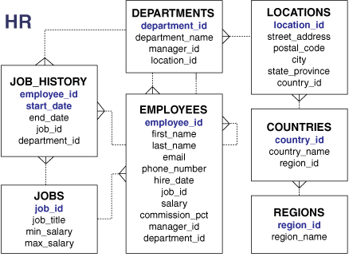
Database sample

Slide 9
Hibernate relationships
Section 02
Notes:
http://www.vertabelo.com/blog/technical-articles/how-to-set-up-a-composite-primary-key-in-jooq-and-hibernate

Slide 10
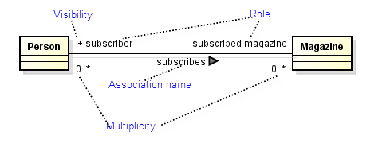
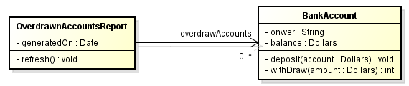
Association Relationship
Represents the static relationship shared among the objects of two classes.
Bi-directional:
both classes are aware of each other and their relationship
Uni-directional:
two classes are related, but only one class knows that the relationship exists (overdrawn: thấu chi, counselor: nhân viên)

Slide 11
Association Relationship
Hibernate mapping is one of the essential features of Hibernate: “how the objects of persistent classes are associated with each other”. Hibernate provides four types of association mapping:
One To One
One To Many
Many To One
Many To Many
Student
1
1
Address
Jobs
1
*
Employees
Employees
*
1
Jobs
Categories
*
*
Items

Slide 12
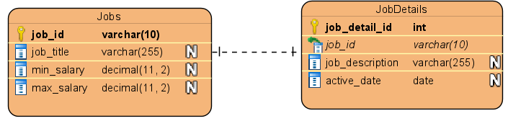
One-to-One Mapping Annotation @JoinColumn
The most widely used and uses a foreign key column in one of the tables.
Use @OneToOne mappedBy and @JoinColumn & attribute when foreign key is held by one of the entities.
Example:
@OneToOne(mappedBy = "job")
private JobDetails jobDetail;
@OneToOne
@JoinColumn(name = "job_id")
private Jobs job;
Notes:
https://howtodoinjava.com/hibernate/hibernate-one-to-one-mapping-using-annotations/

Slide 13
One-to-One Mapping Annotation @JoinColumn
@Entity
@Table(schema = "dbo", name = "Jobs",
indexes = {@Index(columnList = "job_id, job_title", name = "IDX_ID_TITLE") })
public class Jobs {
@Id
@Column(name = "job_id", length = 10)
private String jobId;
@Column(name = "job_title", length = 255, nullable = false, unique = true)
private String jobTitle;
@Column(name = "min_salary", precision = 11, scale = 2)
private double minSalary;
@Column(name = "max_salary", precision = 11, scale = 2)
private double maxSalary;
@OneToOne(mappedBy = "job")
private JobDetails jobDetail;
public Jobs() {
}
// Constructors with params
// getter and setter methods
public JobDetails getJobDetail() {
return jobDetail;
}
public void setJobDetails(JobDetails jobDetail) {
this.jobDetail = jobDetail;
}
}

Slide 14
One-to-One Mapping Annotation @JoinColumn
@Entity
@Table(name = "JobDetails", schema = "dbo")
public class JobDetails {
@Id
@GeneratedValue(strategy = GenerationType.AUTO)
@Column(name = "job_detail_id")
private int jobDetailId;
@Column(name = "job_description", length = 255)
private String jobDescription;
@Column(name = "active_date")
private LocalDate activeDate;
@OneToOne
@JoinColumn(name = "job_id", referencedColumnName = "job_id")
private Jobs job;
public JobDetails() {
}
// Constructors with params
// getter and setter methods
public Jobs getJob() {
return job;
}
public void setJob(Jobs job) {
this.job = job;
}
}

Slide 15
One-to-One Mapping Annotation @JoinColumn
“cascade” attribute: An entity defines “cascade=CascadeType.ALL” and it essentially means that any change happened on Jobs must cascade to JobDetails as well.
If you save a Job, then a JobDetail will also be saved into database.
If you delete a Job then a JobDetail associated with that Job also be deleted.
If we only want to cascade one of operations, then we can use one of cascade types as below:
CascadeType.PERSIST : cascade type presist means that save() or persist() operations cascade to related entities.
CascadeType.MERGE : cascade type merge means that related entities are merged when the owning entity is merged.
CascadeType.REFRESH : cascade type refresh does the same thing for the refresh() operation.
CascadeType.REMOVE : cascade type remove removes all related entities association with this setting when the owning entity is deleted.
CascadeType.DETACH : cascade type detach detaches all related entities if a “manual detach” occurs.
CascadeType.ALL : cascade type all is shorthand for all of the above cascade operations.

Slide 16
One-to-One Mapping Annotation @JoinColumn
Update Jobs class:
@Entity
@Table(schema = "dbo", name = "Jobs",
indexes = {@Index(columnList = "job_id, job_title", name = "IDX_ID_TITLE") })
public class Jobs {
// …
@OneToOne(cascade = CascadeType.ALL, mappedBy = "job")
private JobDetails jobDetail;
public Jobs() {
}
// Constructors with params
// getter and setter methods
public JobDetails getJobDetail() {
return jobDetail;
}
public void setJobDetails(JobDetails jobDetail) {
this.jobDetail = jobDetail;
}
}

Slide 17
One-to-One Mapping Annotation @JoinColumn
Create a JobDao class:
public class JobDaoImpl implements JobDao {
@Override
public boolean save(Jobs job) throws Exception {
Session session = null;
Transaction transaction = null;
try {
session = HibernateUtils.getSessionFactory().openSession();
transaction = session.beginTransaction();
Serializable result = session.save(job);
transaction.commit();
return (result != null);
} finally {
if (session != null) {
session.close();
}
}
}
}

Slide 18
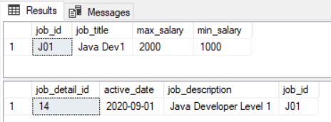
One-to-One Mapping Annotation @JoinColumn
class JobDaoTest {
static JobDao jobDao;
@BeforeAll
static void setUpBeforeClass() throws Exception {
jobDao = new JobDaoImpl();
}
@Test
void testSave1() throws Exception {
JobDetails jobDetail = new JobDetails("Java Developer Level 1", LocalDate.of(2020, 9, 1));
Jobs job = new Jobs("J01", "Java Dev1", 1000, 2000);
job.setJobDetails(jobDetail);
jobDetail.setJob(job);
assertEquals(true, jobDao.save(job));
}
}
Oct 05, 2020 10:16:35 AM org.hibernate.engine.transaction.jta.platform.internal.JtaPlatformInitiator initiateService
INFO: HHH000490: Using JtaPlatform implementation: [org.hibernate.engine.transaction.jta.platform.internal.NoJtaPlatform]
Hibernate: select next value for hibernate_sequence
Hibernate: insert into dbo.Jobs (job_title, max_salary, min_salary, job_id) values (?, ?, ?, ?)
Hibernate: insert into dbo.JobDetails (active_date, job_id, job_description, job_detail_id) values (?, ?, ?, ?)
Results:

Slide 19
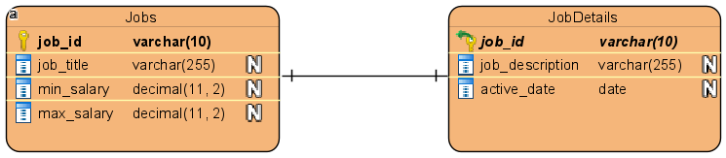
One-to-One Mapping Annotation @PrimaryKeyJoinColumn
A technique is something new which uses a common primary key value in both the tables.
Use @OneToOne mappedBy and @PrimaryKeyJoinColumn for associated entities sharing the same primary key.
Example:
@OneToOne
@PrimaryKeyJoinColumn
private JobDetails jobDetail;
@OneToOne(mappedBy = "userDetail")
private Jobs job;
Notes:
https://howtodoinjava.com/hibernate/hibernate-one-to-one-mapping-using-annotations/

Slide 20
One-to-One Mapping Annotation @PrimaryKeyJoinColumn
@Entity
@Table(schema = "dbo", name = "Jobs", indexes = {@Index(columnList = "job_id, job_title", name = "IDX_ID_TITLE") })
public class Jobs {
@Id
@Column(name = "job_id", length = 10)
private String jobId;
@Column(name = "job_title", length = 255, nullable = false, unique = true)
private String jobTitle;
@Column(name = "min_salary", precision = 11, scale = 2)
private double minSalary;
@Column(name = "max_salary", precision = 11, scale = 2)
private double maxSalary;
@OneToOne (cascade = CascadeType.ALL)
@PrimaryKeyJoinColumn
private JobDetails jobDetail;
public Jobs() {
}
// Constructors with params
// getter and setter methods
public JobDetails getJobDetail() {
return jobDetail;
}
public void setJobDetails(JobDetails jobDetail) {
this.jobDetail = jobDetail;
}
}

Slide 21
One-to-One Mapping Annotation @PrimaryKeyJoinColumn
@Entity
@Table(name = "JobDetails", schema = "dbo")
public class JobDetails {
@Id
@GeneratedValue(generator = "foreigngen")
@GenericGenerator(parameters = {
@Parameter(name = "property", value = "job") }, strategy = "foreign", name = "foreigngen")
@Column(name = "job_id")
private String jobDetailId;
@Column(name = "job_description", length = 255)
private String jobDescription;
@Column(name = "active_date")
private LocalDate activeDate;
@OneToOne(mappedBy = "jobDetail")
private Jobs job;
public JobDetails() {
}
// Constructors with params
// getter and setter methods
public Jobs getJob() {
return job;
}
public void setJob(Jobs job) {
this.job = job;
}
}

Slide 22
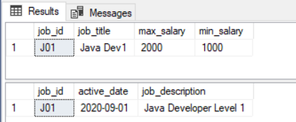
One-to-One Mapping Annotation @PrimaryKeyJoinColumn
Re-run the above test case script, we get the following result:

Slide 23
Collection Mapping
Section 03
Notes:
http://www.vertabelo.com/blog/technical-articles/how-to-set-up-a-composite-primary-key-in-jooq-and-hibernate

Slide 24
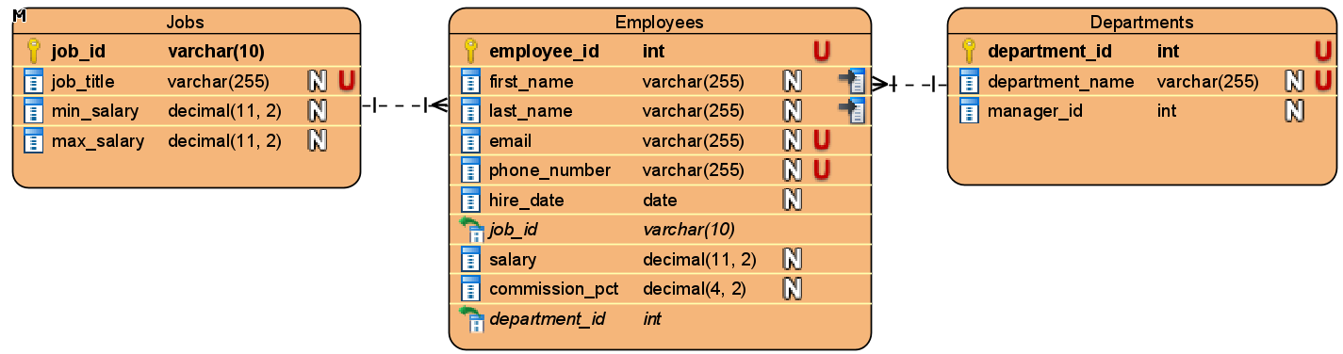
One-to-Many Mapping Annotation @JoinColumn
The most widely used and uses a foreign key column in one of the tables.
Use @OneToOne mappedBy and @JoinColumn & attribute when foreign key is held by one of the entities.
Example:
@OneToMany(cascade = CascadeType.ALL, mappedBy = "job")
private Set<Employees> employees;
@OneToMany(cascade = CascadeType.ALL, mappedBy = “deparment")
private Set<Employees> employees;
@ManyToOne
@JoinColumn(name = "job_id", columnDefinition = "job_id", referencedColumnName = "job_id")
private Jobs job;
Notes:
https://howtodoinjava.com/hibernate/hibernate-one-to-one-mapping-using-annotations/

Slide 25
One-to-Many Mapping Annotation @JoinColumn
Update Jobs class:
@Entity
@Table(schema = "dbo", name = "Jobs", indexes = {
@Index(columnList = "job_id, job_title", name = "IDX_ID_TITLE") })
public class Jobs {
// …
@OneToMany(cascade = CascadeType.ALL, mappedBy = "job")
private Set<Employees> employees;
public Set<Employees> getEmployees() {
return employees;
}
public void setEmployees(Set<Employees> employees) {
this.employees = employees;
}
}

Slide 26
One-to-Many Mapping Annotation @JoinColumn
@Entity
@Table(name = "Employees", schema = "dbo", indexes =
{@Index(columnList = "first_name, last_name",
name = "IDX_EMP_NAME") })
public class Employees {
@Id
@GeneratedValue(strategy = GenerationType.IDENTITY)
@Column(name = "employee_id")
private int employeeId;
@Column(name = "firstName", length = 255, nullable = false)
private String first_name;
@Column(name = "lastName", length = 255, nullable = false)
private String last_name;
@Column(name = "email", length = 255, unique = true)
private String email;
@Column(name = "phone_number", length = 255, unique = true)
private String phoneNumber;
@Column(name = "hire_date")
private LocalDate hireDate;
private double salary;
@Column(name = "commission_pct")
private double commissionPct;
@ManyToOne
@JoinColumn(name = "job_id", columnDefinition = "job_id",
referencedColumnName = "job_id")
private Jobs job;
public Employees() {
}
public Jobs getJob() {
return job;
}
public void setJob(Jobs job) {
this.job = job;
}
}

Slide 27
One-to-Many Mapping Annotation @JoinColumn
Create a EmployeeDaoImpl class:
public class EmployeeDaoImpl implements EmployeeDao{
@Override
public boolean save(Employees employee) throws Exception {
Session session = null;
Transaction transaction = null;
try {
session = HibernateUtils.getSessionFactory().openSession();
transaction = session.beginTransaction();
Serializable result = session.save(employee);
transaction.commit();
return (result != null);
} finally {
if (session != null) {
session.close();
}
}
}
}

Slide 28
One-to-Many Mapping Annotation @JoinColumn
Create a Unit Test Script to test the above EmployeeDaoImpl class:
class EmployeeDaoTest {
static EmployeeDao employeeDao;
@BeforeAll
static void setUpBeforeClass() throws Exception {
employeeDao = new EmployeeDaoImpl();
}
@Test
void testSave() throws Exception {
Employees employee = new Employees("Nguyen", "Quang Anh",
"anhnd22@fsoft.com.vn", "0988777666", LocalDate.of(2019, 1, 1), 1000, 1.1);
employee.setJob(job);
assertTrue(employeeDao.save(employee));
}
}

Slide 29
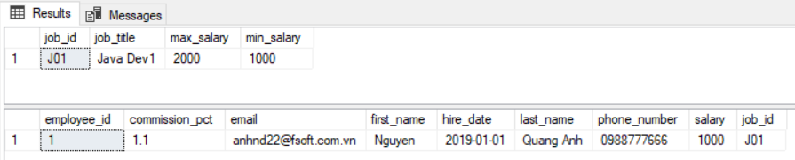
One-to-Many Mapping Annotation @JoinColumn
Results:
Console:
Hibernate: create table dbo.Employees (employee_id int identity not null, commission_pct double precision, email varchar(255), first_name varchar(255) not null, hire_date date, last_name varchar(255) not null, phone_number varchar(255), salary double precision not null, job_id varchar(10), primary key (employee_id))
Hibernate: create index IDX_EMP_NAME on dbo.Employees (first_name, last_name)
Hibernate: alter table dbo.Employees drop constraint UK_76snkombmttoxvdljjqo42mmc
Hibernate: alter table dbo.Employees add constraint UK_76snkombmttoxvdljjqo42mmc unique (email)
Hibernate: alter table dbo.Employees drop constraint UK_ivjoyqecd8hc1w4411q70eqri
Hibernate: alter table dbo.Employees add constraint UK_ivjoyqecd8hc1w4411q70eqri unique (phone_number)
Hibernate: alter table dbo.Employees add constraint FKsrmrlbhpjhvfet64uvyt0j7cw foreign key (job_id) references dbo.Jobs
Oct 05, 2020 11:34:00 AM org.hibernate.engine.transaction.jta.platform.internal.JtaPlatformInitiator initiateService
INFO: HHH000490: Using JtaPlatform implementation: [org.hibernate.engine.transaction.jta.platform.internal.NoJtaPlatform]
Hibernate: select jobs_.job_id, jobs_.job_title as job_titl2_2_, jobs_.max_salary as max_sala3_2_, jobs_.min_salary as min_sala4_2_
from dbo.Jobs jobs_ where jobs_.job_id=?
Hibernate: insert into dbo.Employees (commission_pct, email, first_name, hire_date, job_id, last_name, phone_number, salary)
values (?, ?, ?, ?, ?, ?, ?, ?)

Slide 30
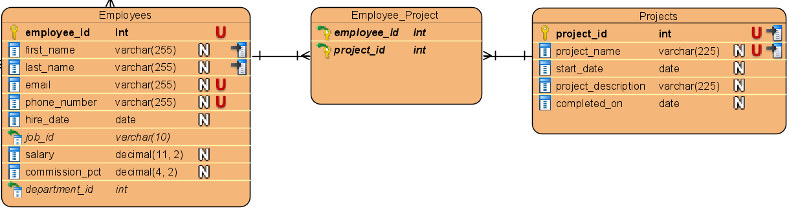
Many-to-Many Mapping Annotation @JoinTable
To map a many-to-many association, we use the @ManyToMany, @JoinTable and @JoinColumn annotations.
@ManyToMany(mappedBy = "projects")
private Set<Employees> employees;
@ManyToMany(cascade = CascadeType.ALL)
@JoinTable(name = "Employee_Project", schema = "dbo",
joinColumns = {@JoinColumn(referencedColumnName = "employee_id") },
inverseJoinColumns = { @JoinColumn(
referencedColumnName = "project_id") })
private Set<Projects> projects;

Slide 31
Many-to-Many Mapping Annotation @JoinTable
Update Employees class:
@Entity
@Table(name = "Employees", schema = "dbo", indexes = {
@Index(columnList = "first_name, last_name", name = "IDX_EMP_NAME") })
public class Employees {
// …
@Id
@GeneratedValue(strategy = GenerationType.IDENTITY)
@Column(name = "employee_id")
private int employeeId;
@ManyToMany(cascade = CascadeType.ALL)
@JoinTable(name = "Employee_Project", schema = "dbo",
joinColumns = { @JoinColumn(referencedColumnName = "employee_id") },
inverseJoinColumns = { @JoinColumn(referencedColumnName = "project_id") })
private Set<Projects> projects;
public Set<Projects> getProjects() {
return projects;
}
public void setProjects(Set<Projects> projects) {
this.projects = projects;
}
// …
// Constructors with params (if need)
// getter and setter methods
}

Slide 32
Many-to-Many Mapping Annotation @JoinTable
Create Projects class:
@Entity
@Table(name = "Projects", schema = "dbo")
public class Projects {
@Id
@GeneratedValue(strategy = GenerationType.IDENTITY)
@Column(name = "project_id")
private int projectId;
@Column( name = "project_name", length = 255,
nullable = false, unique = true)
private String projectName;
@Column(name = "start_date")
private LocalDate startDate;
@Column(name = "project_description")
private String projectDescription;
@Column(name = "completed_on")
private LocalDate completedOn;
@ManyToMany(cascade = CascadeType.ALL, mappedBy = "projects")
private Set<Employees> employees;
public Projects() {
}
// Constructors with params (if need)
// getter and setter methods
public Set<Employees> getEmployees() {
return employees;
}
public void setEmployees(Set<Employees> employees) {
this.employees = employees;
}
}

Slide 33
Many-to-Many Mapping Annotation @JoinTable
Create class ProjectDaoImpl:
public class ProjectDaoImpl implements ProjectDao {
@Override
public boolean save(Projects project) {
Session session = null;
Transaction transaction = null;
try {
session = HibernateUtils.getSessionFactory().openSession();
transaction = session.beginTransaction();
Serializable result = session.save(project);
transaction.commit();
return (result != null);
} finally {
if (session != null) {
session.close();
}
}
}
}

Slide 34
Many-to-Many Mapping Annotation @JoinTable
Create a Unit Test Script to test the ProjectDaoImpl above class:
class ProjectDaoTest {
static ProjectDao projectDao;
@BeforeAll
static void setUpBeforeClass() throws Exception {
projectDao = new ProjectDaoImpl();
}
@Test
void testSave() throws Exception {
Employees employee = new Employees("Nguyen", "Dang Khoa",
"khoadk@fsoft.com.vn", "0988777665", LocalDate.of(2019, 1, 1), 1000, 1.1);
Projects project = new Projects("IT Fundamental", LocalDate.of(2020, 10, 1),
"Fsoft Academey It Fundamental Training Program", LocalDate.of(2020, 12, 31));
Set<Employees> employees = new HashSet<>();
employees.add(employee);
Set<Projects> projects = new HashSet<>();
projects.add(project);
project.setEmployees(employees);
employee.setProjects(projects);
assertTrue(projectDao.save(project));
}
}

Slide 35
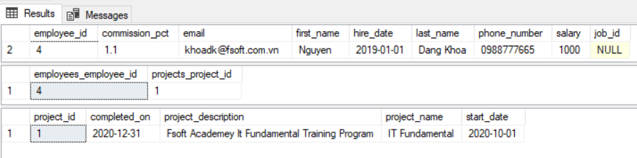
Many-to-Many Mapping Annotation @JoinTable
Results:
Console:
Oct 05, 2020 3:29:02 PM org.hibernate.engine.transaction.jta.platform.internal.JtaPlatformInitiator initiateService
INFO: HHH000490: Using JtaPlatform implementation: [org.hibernate.engine.transaction.jta.platform.internal.NoJtaPlatform]
Hibernate: insert into dbo.Projects (completed_on, project_description, project_name, start_date) values (?, ?, ?, ?)
Hibernate: insert into dbo.Employees (commission_pct, email, first_name, hire_date, job_id, last_name, phone_number, salary)
values (?, ?, ?, ?, ?, ?, ?, ?)
Hibernate: insert into dbo.Employee_Project (employees_employee_id, projects_project_id) values (?, ?)

Slide 36
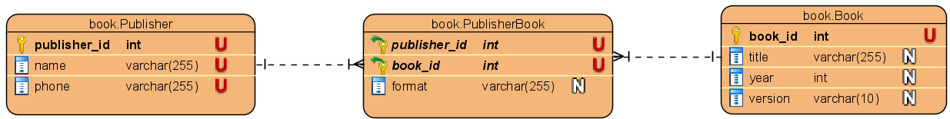
Many-to-Many Mapping Annotation
Map a many-to-many association with extra columns.
Many-to-Many Using a Composite Key
Note, that there’re some key requirements, which a composite key class has to fulfill:
We have to mark it with @Embeddable
It has to implement java.io.Serializable
We need to provide an implementation of the hashcode() and equals() methods
None of the fields can be an entity themselves.
@OneToMany(cascade = CascadeType.ALL,
mappedBy = "publisher")
private Set<PublisherBook> publisherBook;
@OneToMany(cascade = CascadeType.ALL,
mappedBy = "book")
private Set<PublisherBook> publisherBook;

Slide 37
Many-to-Many Mapping Annotation
@Entity
@Table(name = "Publisher_Book", schema = "book")
public class PublisherBook implements Serializable {
private static final long serialVersionUID = 1L;
@Id
@ManyToOne
@JoinColumn(name = "publisher_id")
private Publisher publisher;
@Id
@ManyToOne
@JoinColumn(name = "book_id")
private Book book;
// getter and setter methods
@Override
public int hashCode(){}
@Override
public boolean equals(Object obj)
}

Slide 38
Many-to-Many Mapping Annotation
Create a test script to check:
class PublisherBookDaoTest {
static PublisherBookDao publisherBookDao;
static BookDao bookDao;
static PublisherDao publisherDao;
@BeforeAll
static void setUpBeforeClass() throws Exception {
publisherBookDao = new PublisherBookDao();
bookDao = new BookDao();
publisherDao = new PublisherDao();
}
@Test
void testSave2() throws Exception {
Book book = new Book(1, "Java SE", 2020, "1.0");
assertTrue(bookDao.save(book));
Publisher publisher = new Publisher(1, "NXB GD", "0979867234");
assertTrue(publisherDao.save(publisher));
PublisherBook publisherBook = new PublisherBook(publisher, book, "ABC");
assertTrue(publisherBookDao.save(publisherBook));
}
}

Slide 39
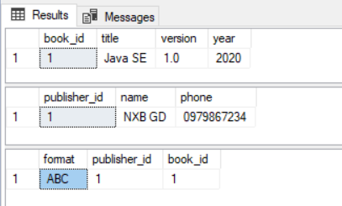
Many-to-Many Mapping Annotation
Results:
Console:
Hibernate: create table book2.Book (book_id int identity not null, title varchar(255), version varchar(10), year int not null, primary key (book_id))
Hibernate: create table book2.Publisher (publisher_id int identity not null, name varchar(255), phone varchar(255), primary key (publisher_id))
Hibernate: create table book2.Publisher_Book (format varchar(255), publisher_id int not null, book_id int not null, primary key (publisher_id, book_id))
Hibernate: alter table book2.Book drop constraint UK_odppys65lq7q1xbx8o6p6fgxj
Hibernate: alter table book2.Book add constraint UK_odppys65lq7q1xbx8o6p6fgxj unique (title)
Hibernate: alter table book2.Publisher drop constraint UK_era79tsdasvick3e38j0e9b6v
Hibernate: alter table book2.Publisher add constraint UK_era79tsdasvick3e38j0e9b6v unique (name)
Hibernate: alter table book2.Publisher drop constraint UK_lfeio9fee753ckef2tac2vfku
Hibernate: alter table book2.Publisher add constraint UK_lfeio9fee753ckef2tac2vfku unique (phone)
Hibernate: alter table book2.Publisher_Book add constraint FKt533ea1vy9qjr586kng5g2y0b foreign key (publisher_id) references book2.Publisher
Hibernate: alter table book2.Publisher_Book add constraint FKeylcdt22y4uw61t576re0ps8i foreign key (book_id) references book2.Book
Oct 11, 2020 3:58:30 PM org.hibernate.engine.transaction.jta.platform.internal.JtaPlatformInitiator initiateService
INFO: HHH000490: Using JtaPlatform implementation: [org.hibernate.engine.transaction.jta.platform.internal.NoJtaPlatform]
Hibernate: insert into book2.Book (title, version, year) values (?, ?, ?)
Hibernate: insert into book2.Publisher (name, phone) values (?, ?)
Hibernate: insert into book2.Publisher_Book (format, publisher_id, book_id) values (?, ?, ?)

Slide 40
Lazy loading and Eager loading
Section 04
Notes:
http://www.vertabelo.com/blog/technical-articles/how-to-set-up-a-composite-primary-key-in-jooq-and-hibernate
https://stackoverflow.com/questions/24820969/hibernate-initializelist-vs-setfetchmode#:~:text=1%20Answer&text=Using%20FetchMode%20will%20allow%20you,always%20issue%20a%20new%20select.
LazyInitializationException: https://www.baeldung.com/hibernate-initialize-proxy-exception
<property name="hibernate.enable_lazy_load_no_trans" value="true"/>
This approach is not efficient and also considered an anti-pattern.
(2) Using FetchType.EAGER Strategy
(3) Using Join Fetching
➔ This is the most efficient and fine-grained solution to avoid the LazyInitializationException error.

Slide 41
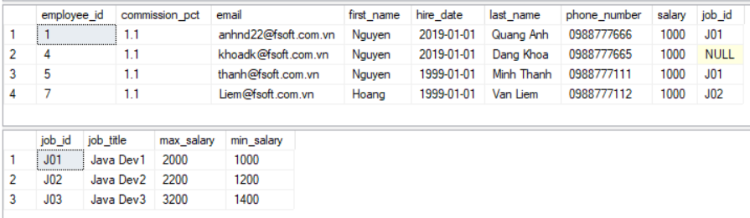
Lazy loading and Eager loading
Eager Loading is a design pattern in which data initialization occurs on the spot
Lazy Loading is a design pattern which is used to defer initialization of an object as long as it's possible

Slide 42
Lazy loading and Eager loading
Differences
One Jobs can have multiple Employees. In eager loading strategy, if we load the Jobs data, it will also load up all employees associated with it and will store it in a memory.
When lazy loading is enabled, if we pull up a JobsLazy, Employees data won't be initialized and loaded into a memory until an explicit call is made to it.
Loading Configuration
@Entity
@Table(schema = "dbo", name = "Jobs", indexes = {
@Index(columnList = "job_id, job_title", name = "IDX_ID_TITLE") })
public class Jobs {
// …
@OneToMany(cascade = CascadeType.ALL, mappedBy = "job", fetch=FetchType.LAZY)
private Set<Employees> employees;
}

Slide 43
Working with lazy associations
Does not actually load all the children when loading the parent.
Load children when requested to do it
Lazy loading can help improve the performance
Create findById() method:
@Override
public Jobs findById(String jobId) throws Exception {
Session session = null;
try {
session = HibernateUtils.getSessionFactory().openSession();
Jobs job = session.get(Jobs.class, jobId);
return job;
} finally {
if (session != null) {
session.close();
}
}
}
Notes:
LAZY: Khái niệm load dữ liệu lười biếng. Nghĩa là bạn nhận được một đối tượng Account, và gọi getOpenBranch() nó trả về một đối tượng Branch, đối tượng này chỉ có cột branchId của nó là có giá trị, thực tế nó chưa load dữ liệu từ Record tương ứng của bảng BRANCH lên. Nó chỉ thực hiện điều đó khi bạn làm gì đó với đối tượng Branch vừa có được, chẳng hạn branch.getName(). EAGER: Khái niệm load dữ liệu lập tức. Nghĩa là bạn nhận được đối tượng Account, và gọi getOpenBranch() trả về đối tượng Branch đã có sẵn các giá trị thuộc tính (name, address, ...). Thực tế dữ liệu nó có được cùng trong 1 lần query với Account.

Slide 44
Working with lazy associations
Use Eager loading:
Use Lazy loading:
Hibernate: sas max_sala3_10_0_, jobs0_.min_salary as min_sala4_10_0_,
employees1_.job_id as job_id9_7_1_, employees1_.employee_id as employee1_7_1_, employees1_.employee_id as employee1_7_2_, employees1_.commission_pct as commissi2_7_2_, employees1_.email as email3_7_2_, employees1_.first_name as first_na4_7_2_, employees1_.hire_date as hire_dat5_7_2_, employees1_.job_id as job_id9_7_2_, employees1_.last_name as last_nam6_7_2_, employees1_.phone_number as phone_nu7_7_2_, employees1_.salary as salary8_7_2_ from dbo.Jobs jobs0_ left outer join dbo.Employees employees1_ on jobs0_.job_id=employees1elect jobs0_.job_id as job_id1_10_0_, jobs0_.job_title as job_titl2_10_0_, jobs0_.max_salary _.job_id where jobs0_.job_id=?
Jobs [jobId=J01, jobTitle=Java Dev1, minSalary=1000.0, maxSalary=2000.0]
Hibernate: select jobs0_.job_id as job_id1_10_0_, jobs0_.job_title as job_titl2_10_0_, jobs0_.max_salary as max_sala3_10_0_, jobs0_.min_salary as min_sala4_10_0_ from dbo.Jobs jobs0_ where jobs0_.job_id=?
Jobs [jobId=J01, jobTitle=Java Dev1, minSalary=1000.0, maxSalary=2000.0]
Notes:
LAZY: Khái niệm load dữ liệu lười biếng. Nghĩa là bạn nhận được một đối tượng Account, và gọi getOpenBranch() nó trả về một đối tượng Branch, đối tượng này chỉ có cột branchId của nó là có giá trị, thực tế nó chưa load dữ liệu từ Record tương ứng của bảng BRANCH lên. Nó chỉ thực hiện điều đó khi bạn làm gì đó với đối tượng Branch vừa có được, chẳng hạn branch.getName(). EAGER: Khái niệm load dữ liệu lập tức. Nghĩa là bạn nhận được đối tượng Account, và gọi getOpenBranch() trả về đối tượng Branch đã có sẵn các giá trị thuộc tính (name, address, ...). Thực tế dữ liệu nó có được cùng trong 1 lần query với Account.

Slide 45
References
Hibernate reference documentation
http://docs.jboss.org/hibernate
www.hibernate.org
Hibernate example
http://www.mkyong.com/hibernate/
Hibernate course
http://courses.coreservlets.com/Course-Materials/hibernate.html
Notes:
Một số vấn đề liên qua đến Hibernate.

Slide 46

Thank you!
Q&A
46

